Slide 1


NLP Transfer Learning with BERT
Yan Zhang February 22, 2019

Slide 2
Content
Introduction
History of BERT
Pre-training
Finetuning
Detail of Transformer

Slide 3
Introduction
Traditional
Step1: design deep Network
Step2: Initialization parameters
Step3: Feed Data
Deep Network
ML model
Big Dataset
More Time

Slide 4
Transfer Learning
data
model
transfer
transfer
Task 1
Step1: Fine tuning
Step2: Feed Data
ML model
Task 2
Step1: Fine tuning
Step2: Feed Data
ML model

Slide 5
Input layer
hidden layer
output layer

Slide 6
hidden layer
Extract feature

Slide 7
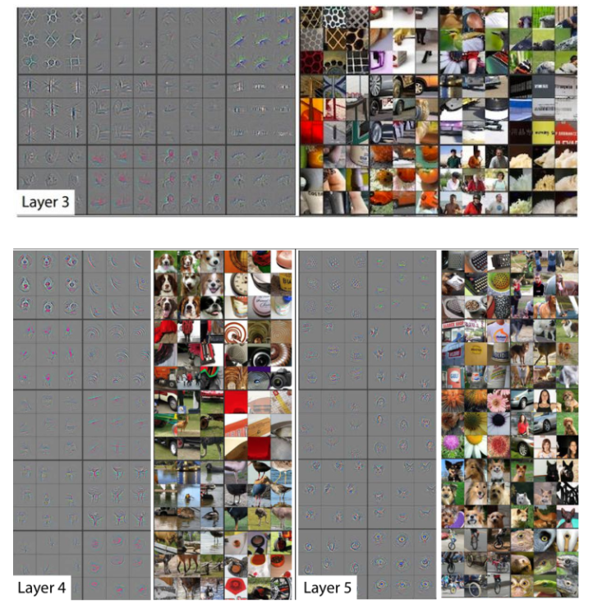
Visualization

Slide 8
Smart dataset
less time

Slide 9
Why does NLP not do this?

Slide 10
Content
Introduction
History of BERT
Pre-training
Finetuning
Detail of Transformer

Slide 11
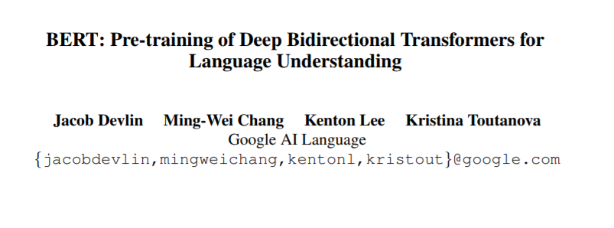
BERT

Slide 12
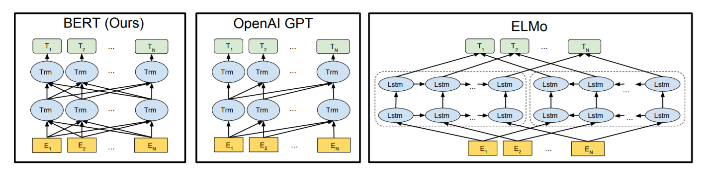

Slide 13
Sentence：
你是一个好人。
Segmentation：
你 /是 /一个 /好人。
N
你
0 | 0 | 0 | 0 | 0 | 0 | 0 | 0 | 0 | … | … | 1 | 0 | 0 | 0 | 0 | 0 | 0 | 0 | 0
N
是
0 | 0 | 0 | 0 | 0 | 0 | 0 | 0 | 0 | … | … | 0 | 0 | 0 | 0 | 1 | 0 | 0 | 0 | 0
N
一个
0 | 0 | 0 | 0 | 0 | 1 | 0 | 0 | 0 | … | … | 0 | 0 | 0 | 0 | 0 | 0 | 0 | 0 | 0
N
好人
0 | 0 | 0 | 0 | 0 | 0 | 0 | 0 | 0 | … | … | 0 | 0 | 0 | 0 | 0 | 0 | 1 | 0 | 0

Slide 14
Word2Vec
M
V
=
0 | 0 | 0 | 1 | … | 0 | 0 | 0 | 0 | 0
X
0 | 5 | 9 | 1 | … | 3 | 6 | 8 | 1 | 7
1 X V

Slide 15
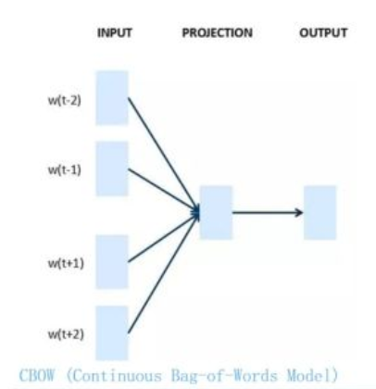
Word2Vec

Slide 16
You are good men
One-hot
You
1 | 0 | 0 | 0
are
0 | 1 | 0 | 0
good
0 | 0 | 1 | 0
men
0 | 0 | 0 | 1
CBOW
Skip-gram
You
1 | 0 | 0 | 0
You
1 | 0 | 0 | 0
W(t-2)
W(t-2)
good
0 | 0 | 1 | 0
good
0 | 0 | 1 | 0
are
0 | 1 | 0 | 0
are
0 | 1 | 0 | 0
Hidden-layer
W(t)
W(t)
Hidden-layer
W(t-1)
W(t-1)
men
0 | 0 | 0 | 1
men
0 | 0 | 0 | 1
W(t+1)
W(t+1)

Slide 17
You are good men
One-hot
You
1 | 0 | 0 | 0
Hidden-layer
are
0 | 1 | 0 | 0
good
0 | 0 | 1 | 0
men
0 | 0 | 0 | 1
训练完毕
W
1 | 8 | 9
2 | 7 | 0
3 | 6 | 1
4 | 5 | 2
x
embedding
good
0 | 0 | 1 | 0
X
=
3 | 6 | 1

Slide 18
Use it
embedding
Deep Network
Data Set
Frozen

Slide 19
Drawback
Bank
Bank

Slide 20
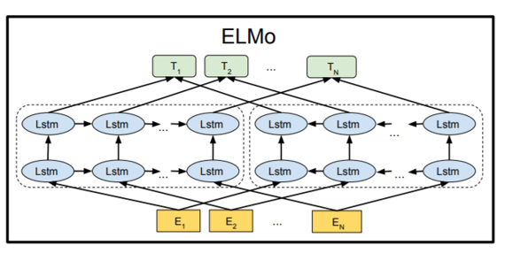
ELMo

Slide 21
embedding1
0 | 5 | 9 | 1 | … | 3 | 6 | 8 | 1 | 7
embedding2
0 | 5 | 9 | 1 | … | 3 | 6 | 8 | 1 | 7
embedding3
0 | 5 | 9 | 1 | … | 3 | 6 | 8 | 1 | 7

Slide 22
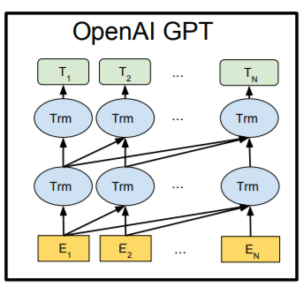
GPT

Slide 23
Transformer!

Slide 24
Use it
embedding
Deep Network
Data Set
Fine tuning

Slide 25
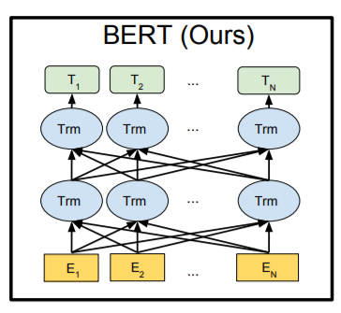
BERT

Slide 26
有钱

Slide 27
BERT-pre training
33,000,000,000,000
MASK ML

Slide 28
Content
Introduction
History of BERT
Pre-training
Finetuning
Detail of Transformer

Slide 29
85%
15%

Slide 30
80%
Original: This is a good job
Change: This is a good [mask]

Slide 31
10%
Original: This is a good job
Change: This is a good terrorist

Slide 32
10%
Original: This is a good job
Change: This is a good job

Slide 33
Shuffle sentence
This is a very good job. Because the salary is relatively high.
Sentence 1
Sentence 2

Slide 34
Content
Introduction
History of BERT
Pre-training
Finetuning
Detail of Transformer

Slide 35
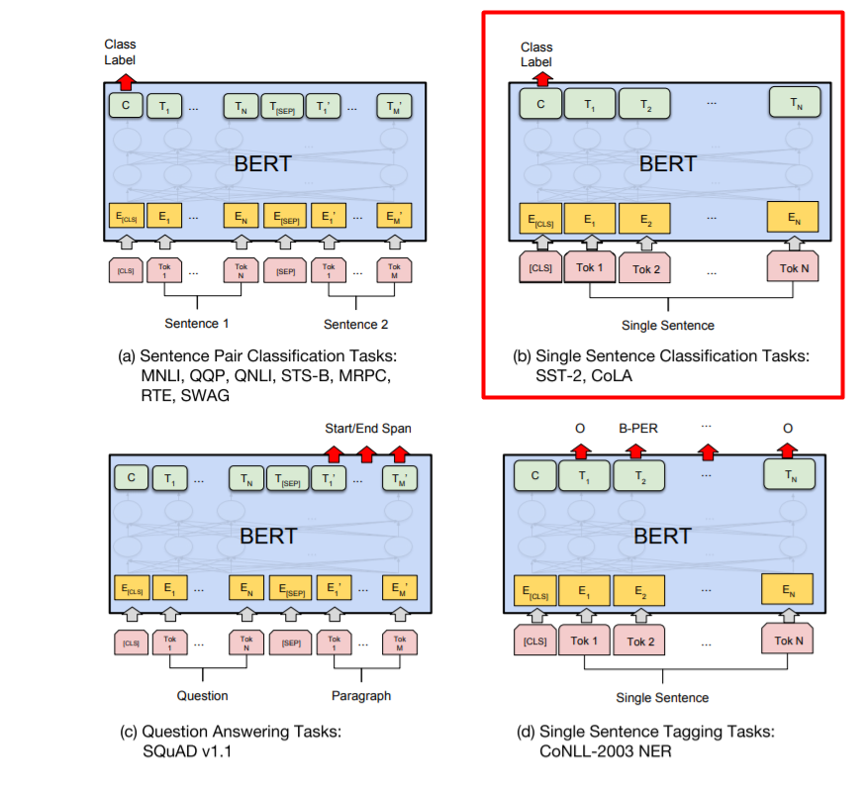
Use it

Slide 36
Content
Introduction
History of BERT
Pre-training
Finetuning
Detail of Transformer

Slide 37
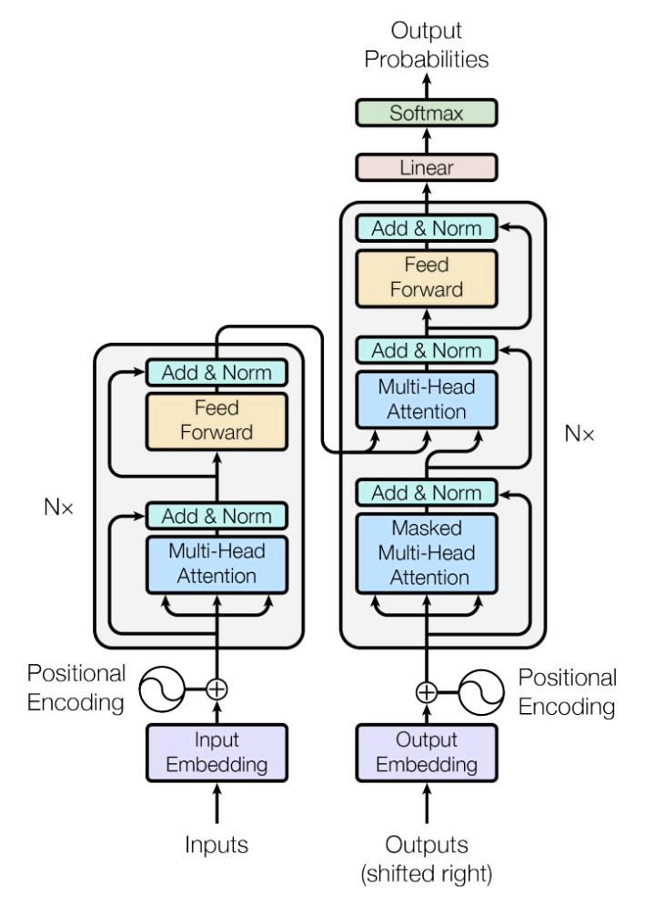

Slide 38
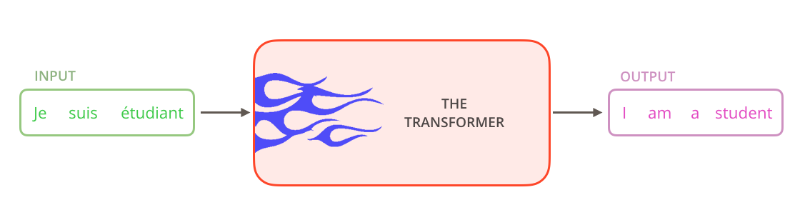

Slide 39
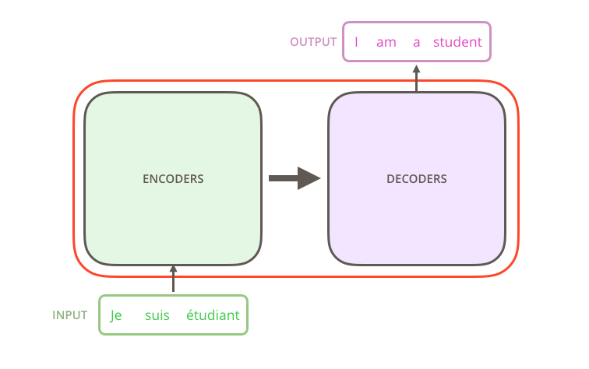
seq2seq

Slide 40
Encoders
Decoders

Slide 41
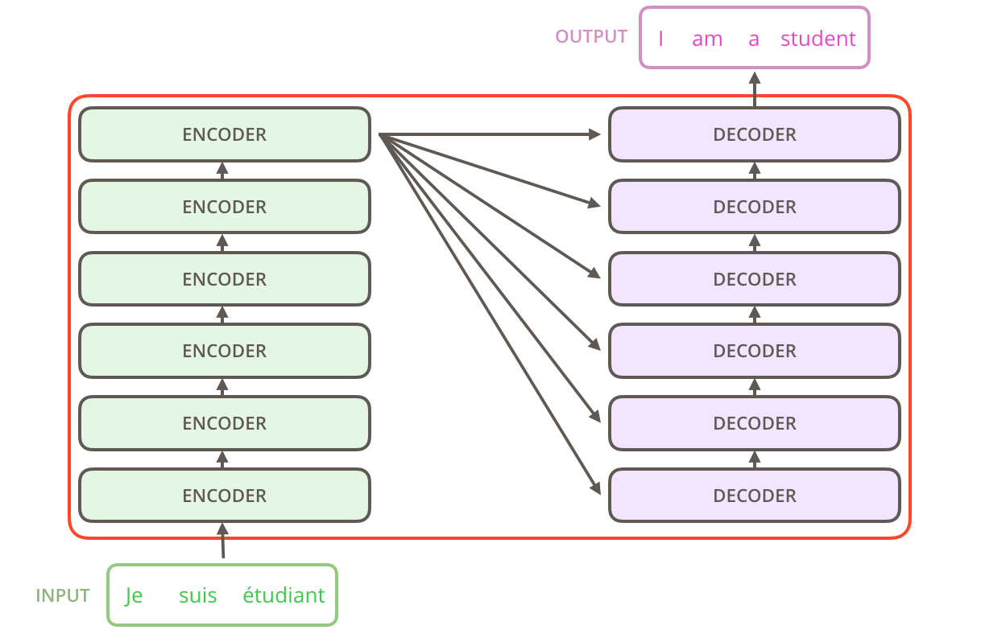

Slide 42
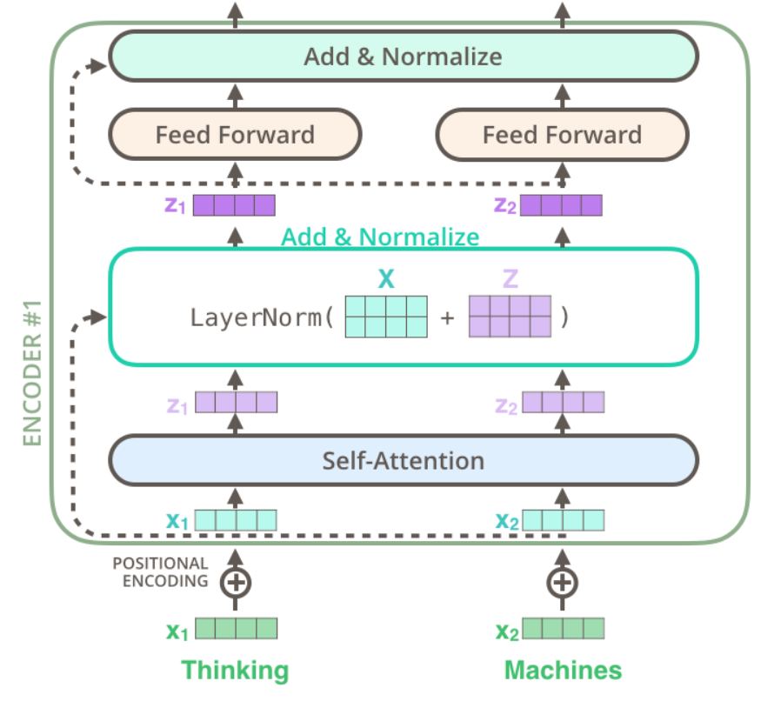
Encoder

Slide 43
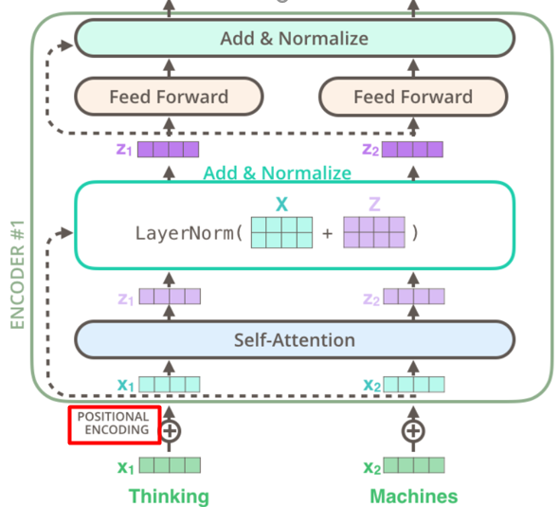
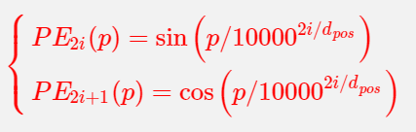
Encoder-Positional Encodding
Notes:
纯attention没办法记录单词的位置信息。

Slide 44
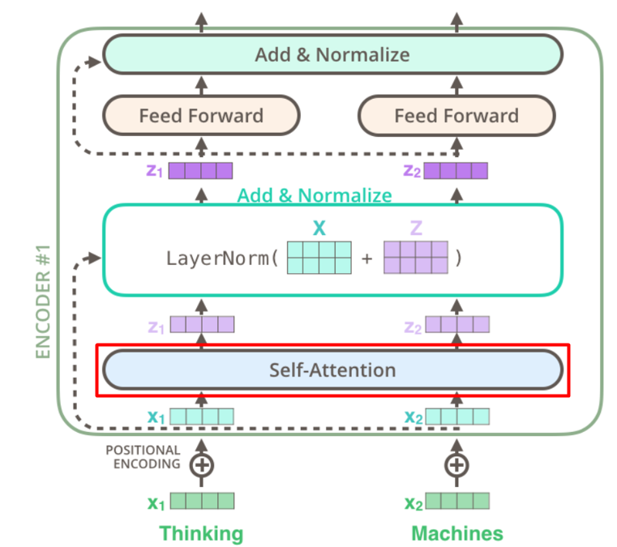

Slide 45

Base-Attention
RNN

Slide 46
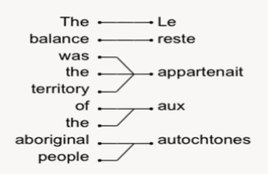
Notes:
单词和词组的对应，跟做翻译一样。

Slide 47
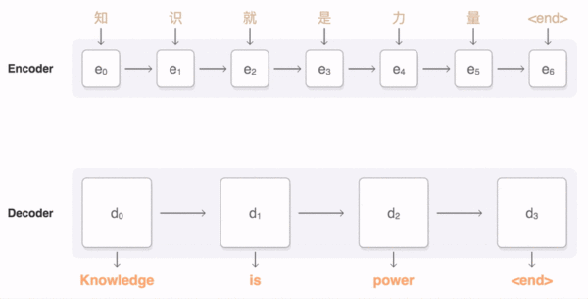

Slide 48
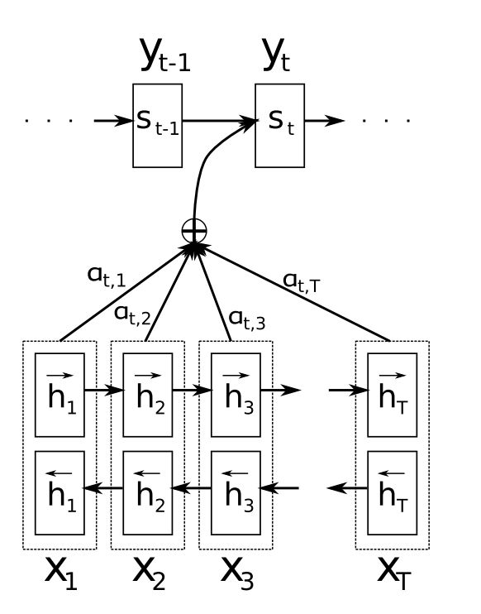
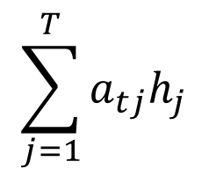
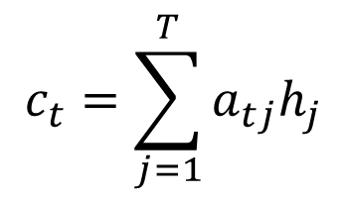
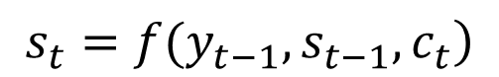
$$\sum_{j=1}^{T}{a_{tj}h_{j}}$$
$$\left.s_{t}=f(y_{t−1},s_{t−1},c_{t}\right)$$
$$c_{t}=\sum_{j=1}^{T}{a_{tj}h_{j}}$$
Notes:
试图找到源语料与目标结果中的部分与部分之间的联系。也就是相关性.

Slide 49
Input sentence:
How are you
output sentence:
How are you
Notes:
当前词与句子中其他词语的一个联系。

Slide 50
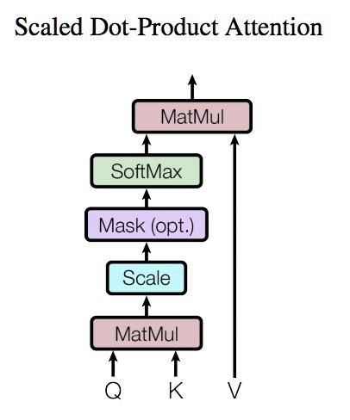
Q(query)，K(key)，V(value)

Slide 51
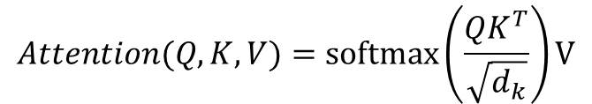
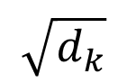
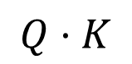
workflow
Step 1 :Matmul
$$Q·K$$
Step 2 : Scale
$$\sqrt{d_{k}}$$
Step 3: Mask
Are you ok?
Are [mask] ok?
Step 4: Softmax
$$Attention(Q,K,V)=softmax\left(\frac{QK^{T}}{\sqrt{d_{k}}}\right)V$$
Notes:
核心部分就是Q(query)，K(key)，V(value)
其中 为一个query和key向量的维度

Slide 52
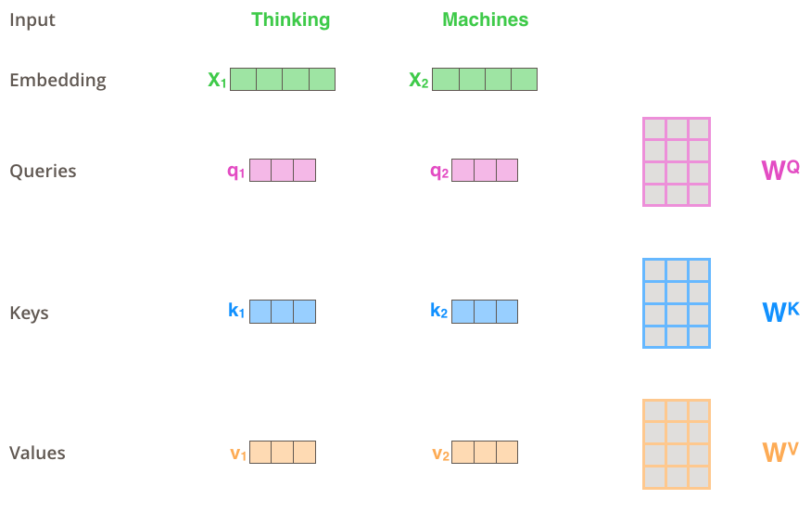
Example

Slide 53
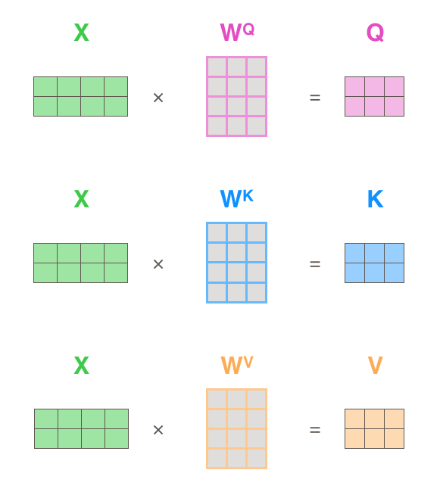
Q,K,V

Slide 54
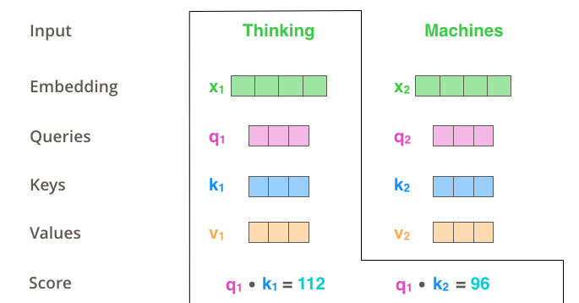
Attention Score

Slide 55
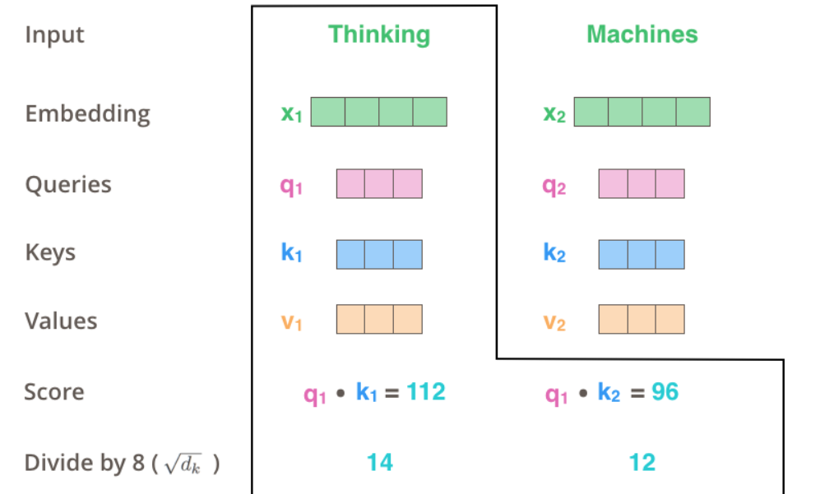
Scale

Slide 56
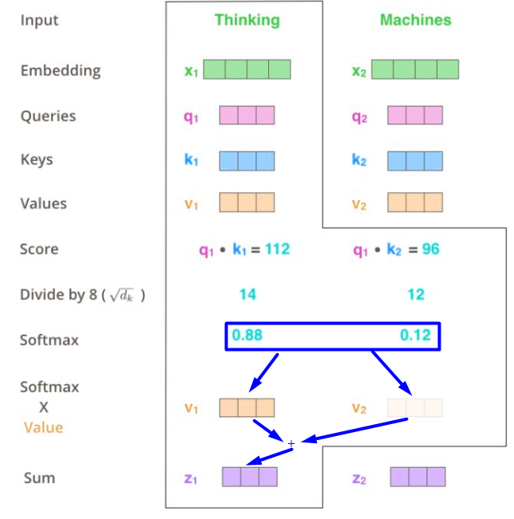
Softmax

Slide 57
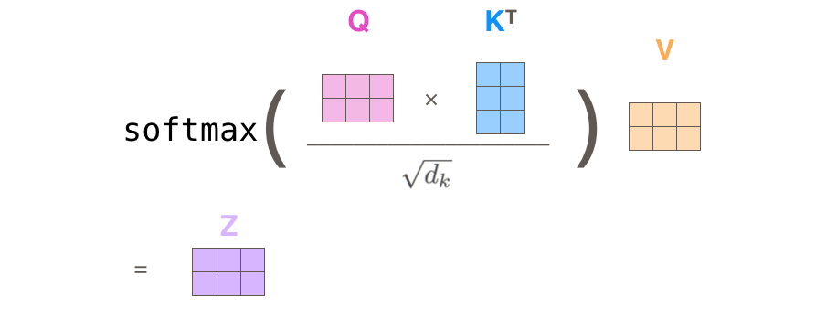
Mat

Slide 58
One-head

Slide 59
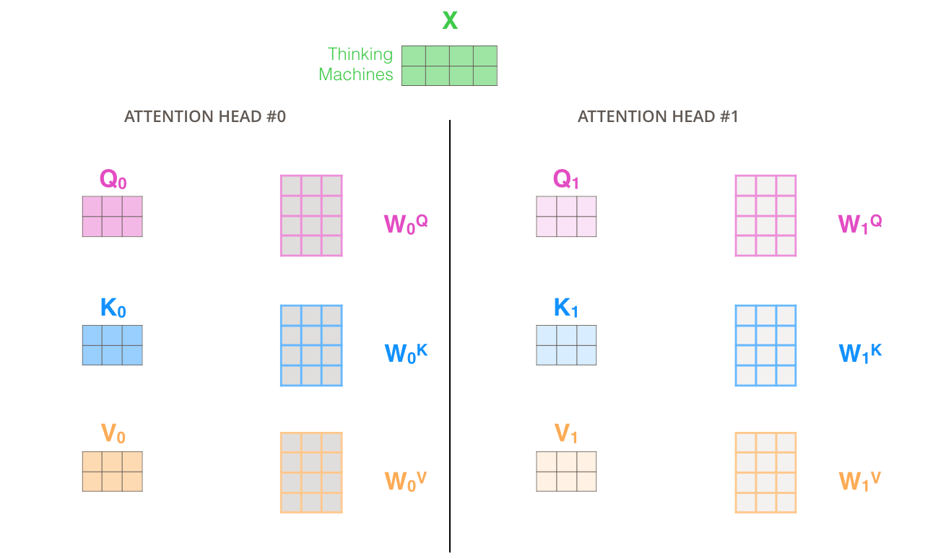
MultHead

Slide 60
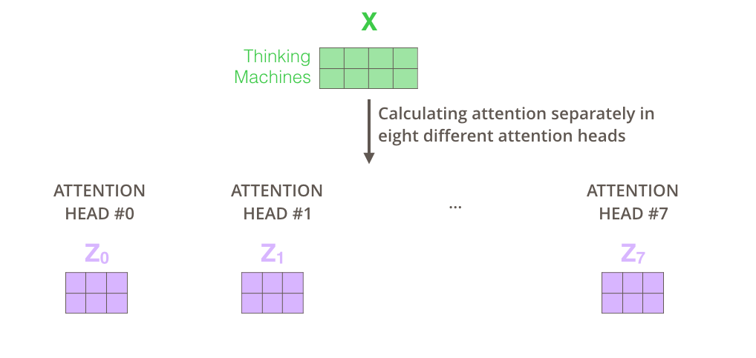
Notes:
Transformer里面有8个头

Slide 61
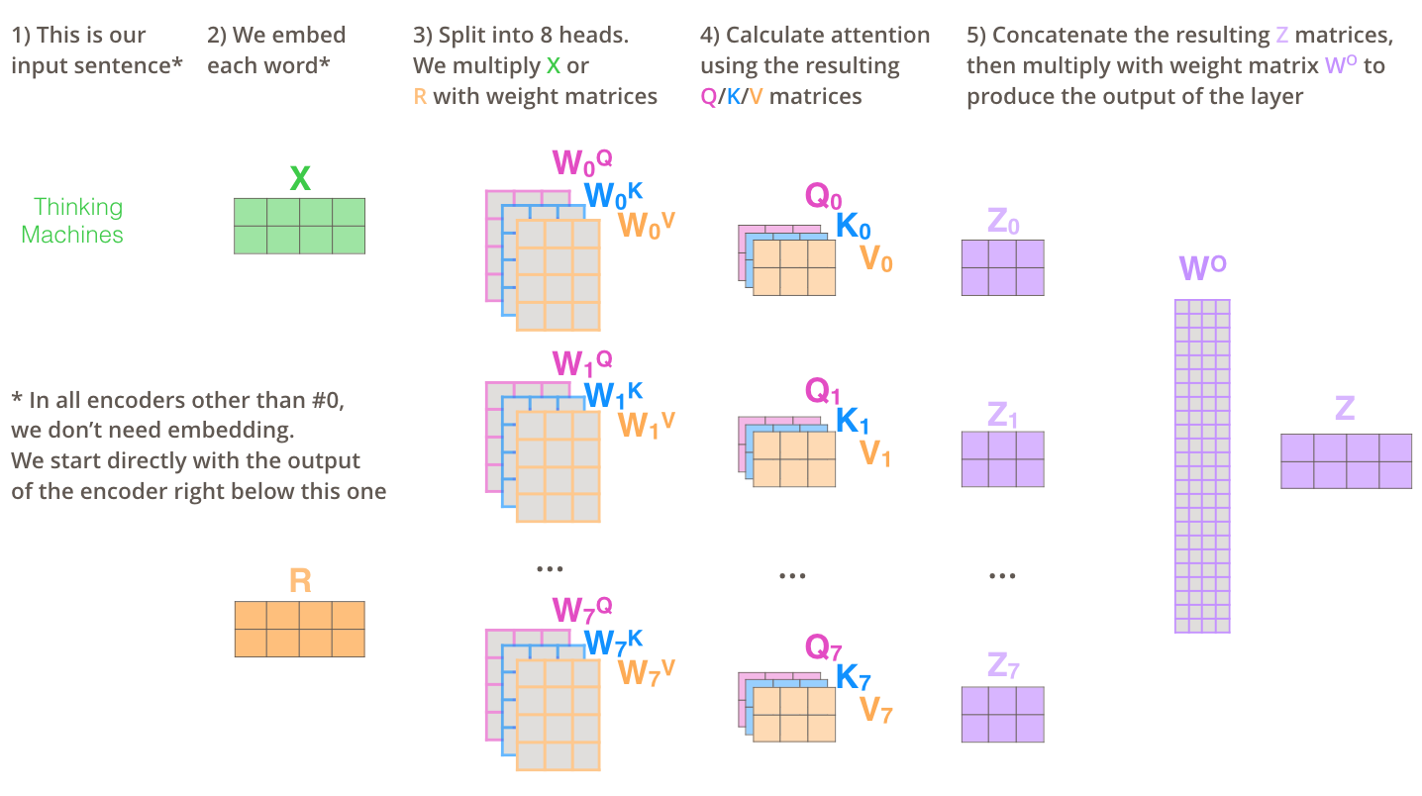

Slide 62
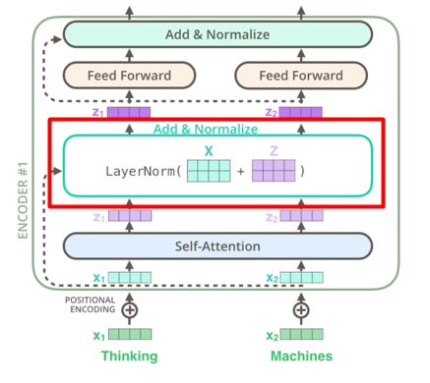
Add & Normalize

Slide 63
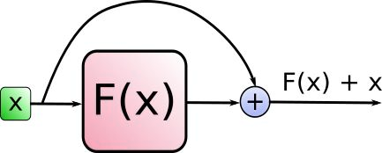
Add
Resnet
Notes:
参考了深度残差网络，防止网络退化问题。

Slide 64
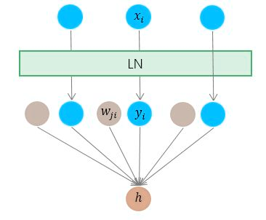
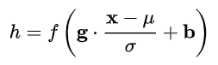
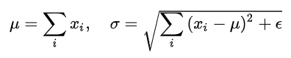
Normalize

Slide 65
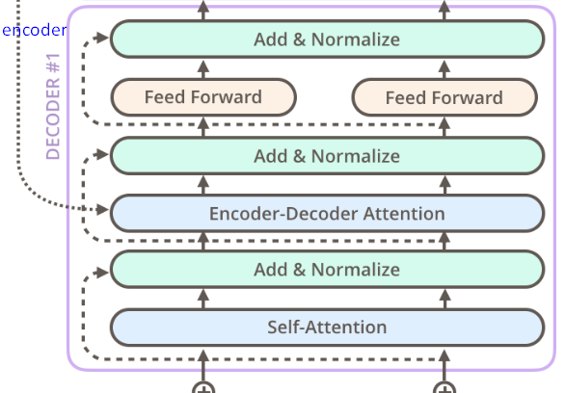
Dencoder

Slide 66
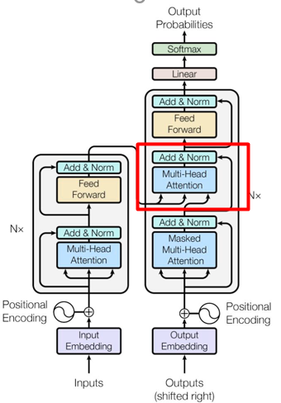
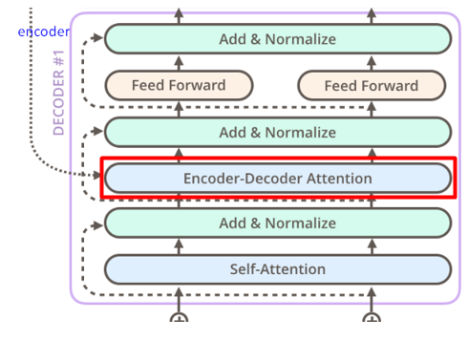
Encoder-Decoder Attention
Notes:
即它的query来自于之前一级的decoder层的输出，但其key和value来自于encoder的输出，这使得decoder的每一个位置都可以attend到输入序列的每一个位置。

Slide 67
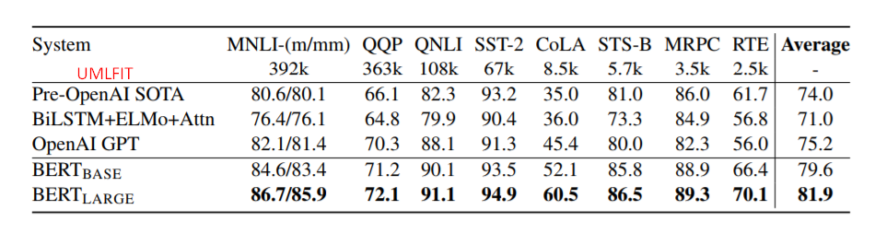
Performance

Slide 68
REFRENCE
https://jalammar.github.io/illustrated-transformer/ （Detail of Transformer）
https://zhuanlan.zhihu.com/p/47282410 (Base-attention)
https://zhuanlan.zhihu.com/p/47063917 (Self-attention)
https://zhuanlan.zhihu.com/p/33173246 (History of NLP transfer learning)
https://arxiv.org/pdf/1810.04805.pdf （Attention）
https://arxiv.org/abs/1706.03762 （Transformer）
https://arxiv.org/abs/1802.05365 （ELMo）
https://s3-us-west-2.amazonaws.com/openai-assets/research-covers/language-unsupervised/language_understanding_paper.pdf （GPT）

Slide 69
Q&A

Slide 70
Thank you

